Slide 1


Corona Time
Chris- Dennis- Adwait-Ahmed-Hein
Hein Naing

Slide 2
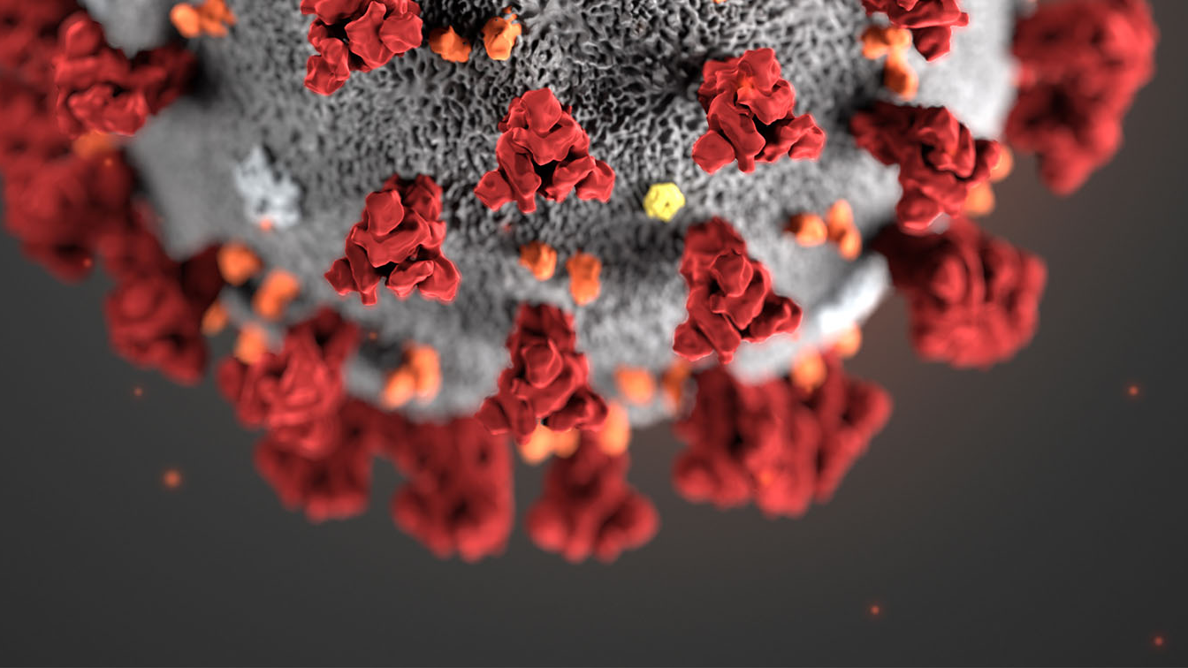
Group Members and Contact
Ahmed Abdulwahab - aabdulw@gmu.edu
Demosthenes Kaloudelis - dkaloude@gmu.edu
Hein Naing - hnaing@gmu.edu
Adwait Srivastava - asrivas@gmu.edu
Chris Trenkov - ctrenkov@gmu.edu
Hein Naing

Slide 3
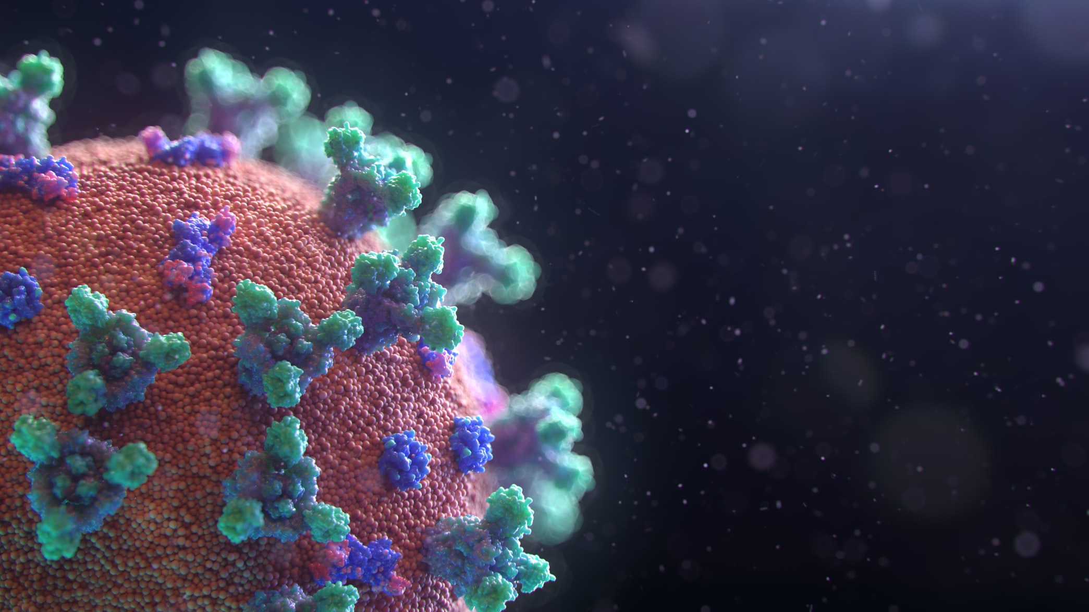
Project Description
We’re studying various strategies and their effectiveness to mitigate the effects highly contagious diseases, like COVID-19
We will be analyzing several mitigation strategies and quarantining strategies via our model
Infection is usually model with differential equations with measured constants from the real world. While these equations are accurate they won't give insight how to predict infection curves given strategies to mitigate the spread on an individual level.
Our model will simulate the infection on an individual level. We will demonstrate the accuracy of our model by comparing it to natural infection curves, and leverage this granular control to perform experiments on the best mitigation/quarantine strategies for diseases.
Hein Naing

Slide 4

The problem
Stopping the infection would be virtually impossible. We want to quantify and understand what the best hypothetical strategies to flatten the infection curve.
This problem is important to understand and solve because our healthcare system can only treat people with a limited through put. If an infection spikes too quickly it is possible some people won't receive treatment and would have a higher likely hood of death
Hein Naing

Slide 5
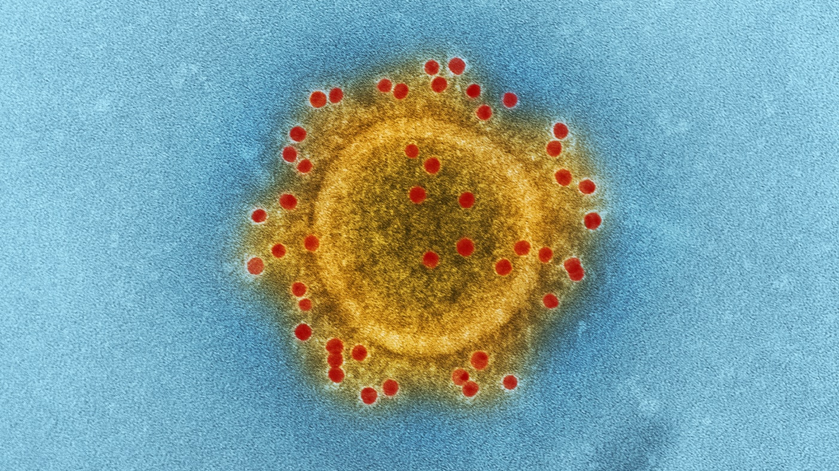
Data Collection and Sanitation
In order to build our model, we decided that we would focus solely on the United States' reporting aggregated by datahub.io. This allowed us to focus on 'accurate' datasets and reduce the amount of noise caused by inaccurate reporting or suppressed reporting
To analyze the problem, we set out to generate several graphs that would illustrate the severity of this pandemic, allow us to validate our model, and compare it to real world data where we can make assumptions.
The data for this virus is widespread in that it is dependent upon correct identification of the virus, accurate reporting of the virus to an appropriate agency, and true and governmental reporting of the data (we're looking at you China)
Demosthenes Kaloudelis

Slide 6
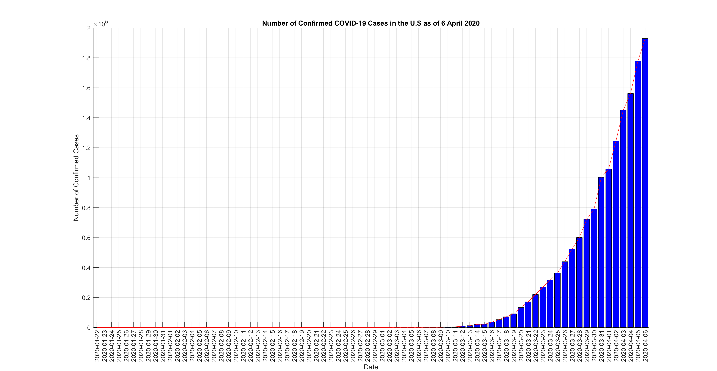
Demosthenes Kaloudelis

Slide 7
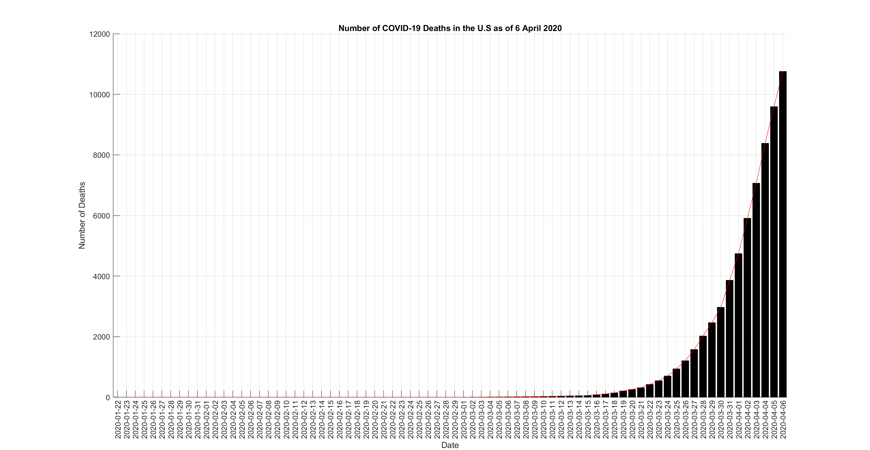
Demosthenes Kaloudelis

Slide 8
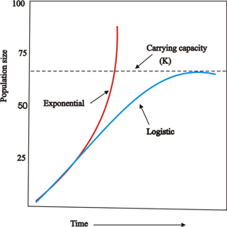
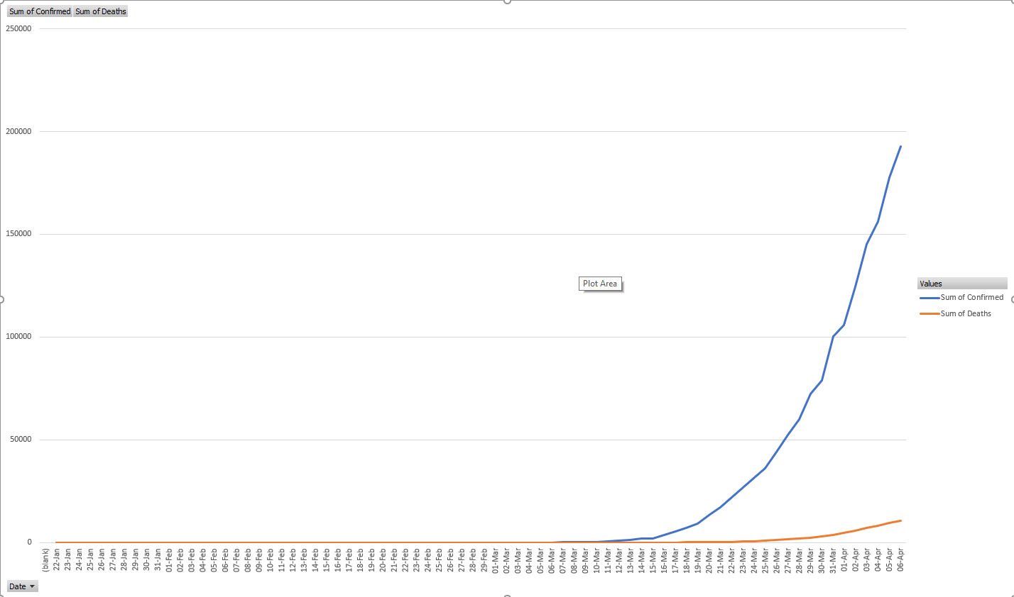

What does the curve look like
As you can see we are in the early stages of infection and death rates grow exponentially.
Because the population is finite, this curve will become logistic and start to flatten out
Our collected and sanitized data for cumulative
confirmed covid infections and deaths in the US
Demosthenes Kaloudelis

Slide 9
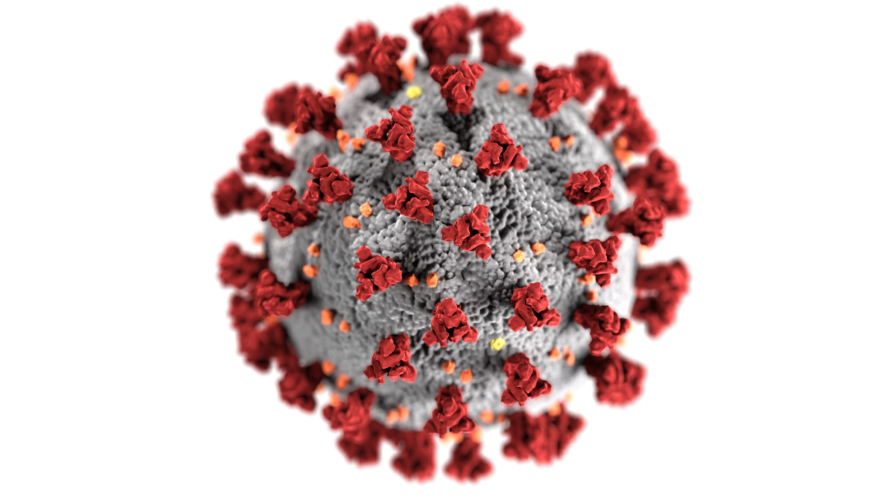

Relevant Equations
$\frac{dS}{dt}= −\frac{βIS}{N}$
$\frac{dI}{dt}= \frac{βIS}{N} − γI$
$\frac{dR}{dt}= γI$
$\frac{dS}{dt}+\frac{dI}{dt}+\frac{dR}{dt} = 0$
The dynamics of the infectious class depends on
$$R_{0}=\frac{β}{γ}$$
Our model will follow the SIR model for infectious growth.
Two important constants for our model will be BETA and GAMMA
BETA controls how susceptible people are to infection
GAMMA controls the rate people "recover" from infection and become resistant
(Note recover also means death by infection)
Our constants won't have units because dynamics of the infection are proportional
Chris Trenkov

Slide 10
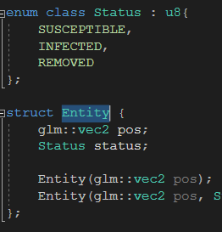
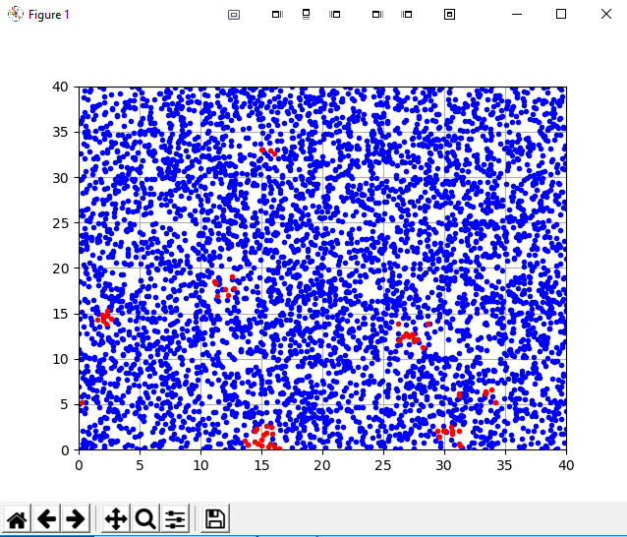
The Model
We chose to model infection spread on an individual level using C++ for its performance
Every human is modeled as an entity structure that stores its position on a 2d plain and stores its current status
Every entity can be susceptible, infected, or removed.
We will have several unitless constants for our model
Infection radius, entity move speed, map area, BETA, GAMMA
Every time step, all entities move, infect, and recover.
Infected entities sample susceptible entities within a small radius and randomly spread infection by a specified constant.
Infected entities also have a random chance to recover by a specific constant
Our model visualized
(red=infected)
Chris Trenkov

Slide 11
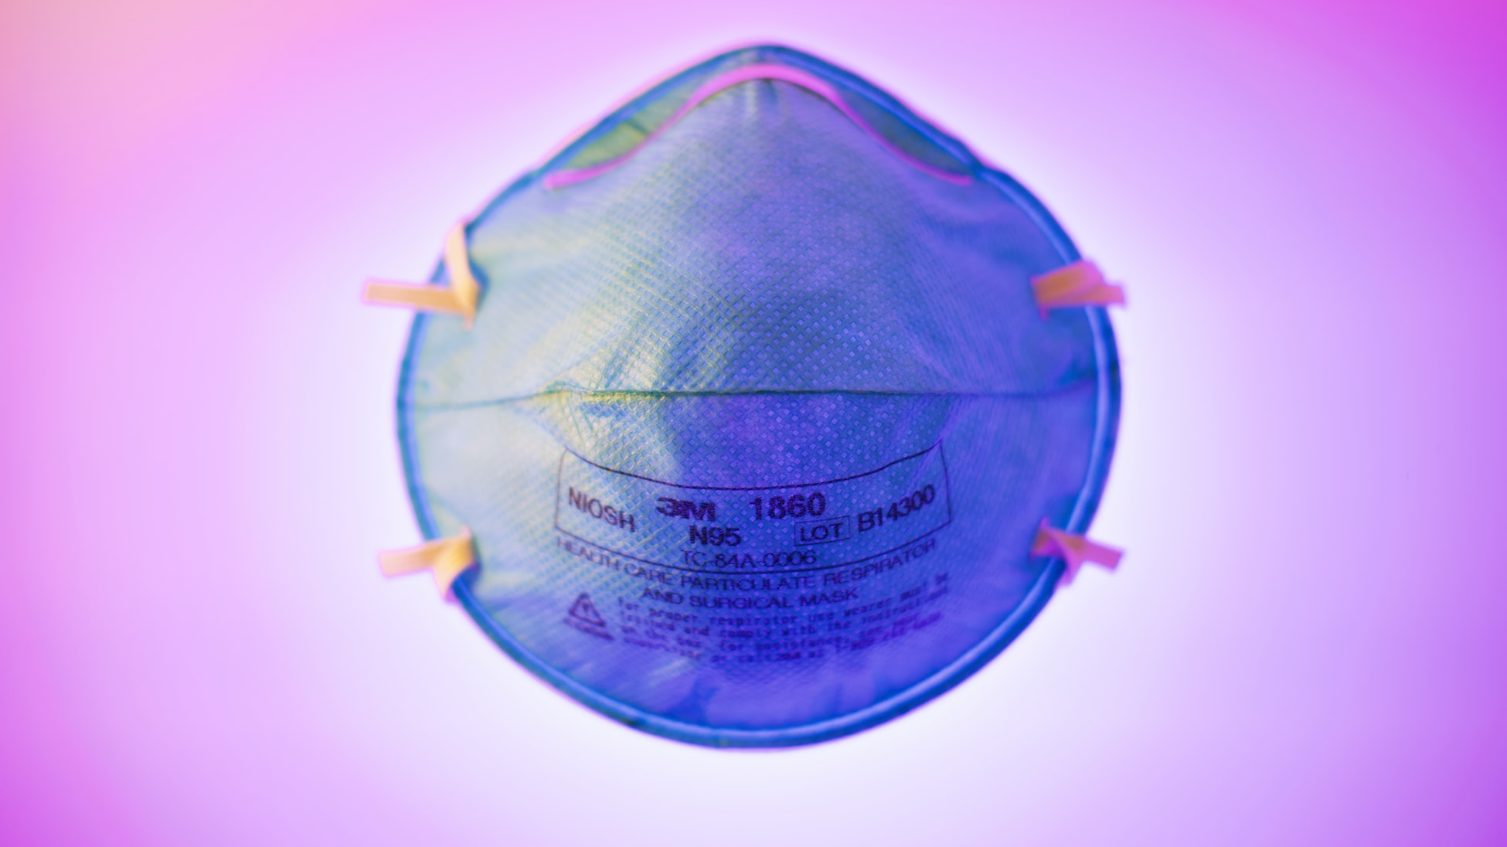
Initial results
It is important that our model accurately simulates disease spread to the real world.
We can validate our model by running our simulation with no strategies in place and with people moving randomly.
Our model produced an infection curve that was initially exponential but as it reached its carrying capacity it flattened out into a logistic curve.
Logistic curves reflect how infections spread in a finite population.
This logistic curve produced by our model validates its ability to model an infectious system on an individual level
On the following slides youll see our models validation output with no strategies in place

Slide 12
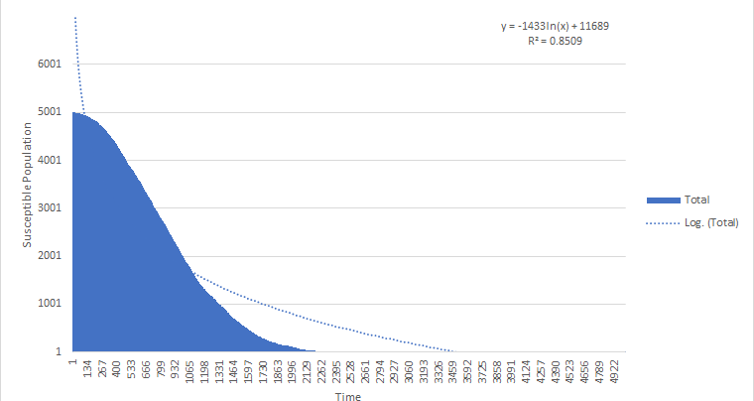
Modeled Susceptible Population vs. Time
Infection rate β = .01
Recovery rate γ = .002
# of people = 5000
Chris Trenkov

Slide 13
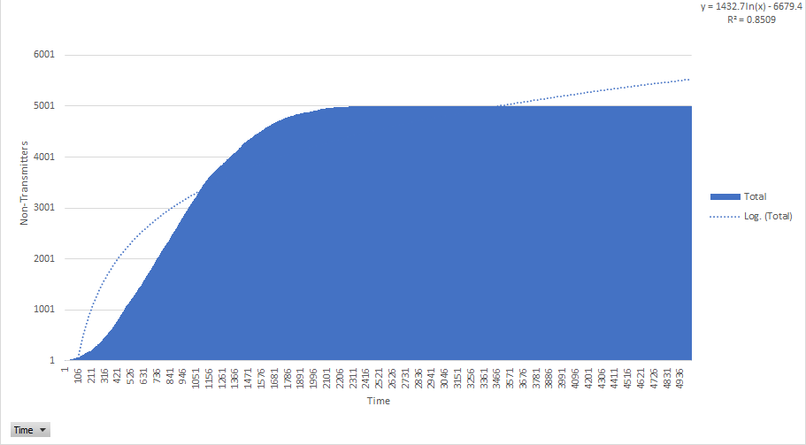
Modeled Recovered Population vs. Time
Infection rate β = .01
Recovery rate γ = .002
# of people = 5000
Chris Trenkov

Slide 14
Initial results 2
Our model also needs to have similar characteristics and dynamics of the SIR differential equations mode.
One important characteristic of the SIR model is the ratio between BETA and GAMMA. Aka reproductivity ratio
If this ratio is above 1, the infection will spread to everyone in the population, if it is less than 1 then it dies out quickly leaving some people unaffected.
Ratios | # People unaffected | # People affected | # Time steps for infection to die
BETA/GAMMA = 0.25 | 2152.97 ± 96.41 | 2857.03 ± 96.41 | 1006.07 ± 45.3
BETA/GAMMA = 1.5 | 0.4455 ± 0.140 | 5009.55 ± 0.140 | 1044.53 ± 23.34
BETA/GAMMA = 4 | 0 ± 0 | 5010 ± 0 | 943.5 ± 26.9
5010 total individuals (5000 susceptible, 10 infected)
100 experiments made
95% confidence interval
Chris Trenkov

Slide 15

What do we expect to answer
We plan to simulate many different hypothetical strategies to mitigate infection spread.
We plan to both simulate and compare full 100% isolation of communities vs 99% isolation of communities.
We plan to simulate strategies to isolate only the detected sick
And are exploring other less popular strategies
Hopefully we can expect to answer the viability for many of these strategies and identify what makes a strategy successful
Adwait Srivastava

Slide 16

Road Blocks
One roadblock we overcame was performance
If we wanted to simulate 5000 people interacting with each other by proximity it would be 5000*4999 (24,995,000) expensive conditional tests every timestep. Unfeasible.
A spatially partitioned data structure was implemented. Entities be partitioned based on their position. Entities will only sample other entities in neighboring partition lists.
With carefully chosen partition sizes this would greatly reduce the number of comparisons needed to be made.
This data structure has no effect on the simulation results itself
Adwait Srivastava

Slide 17
Road Blocks
One roadblock we overcame was performance
If we wanted to simulate 5000 people interacting with each other by proximity it would be (5000*4999) conditional tests every timestep. Unfeasible.
A spatially partitioned data structure was implemented. Entities would only sample other entities in neighboring partition lists.

Slide 18
Road Blocks
Another problem we continue to face is handling large amounts of output data
Our model produces lots of data,
We need to understand what output data is relevant for the conclusions we want to make
Visualizing data has also been a bottle neck for performing analysis
We expect to get more familiar with python and MATLAB to perform our data analysis
Ahmed Abdulwahab

Slide 19

Milestones
Further validate our model is accurate to the real world
Extend our model to simulate deaths and simulate probabilistic testing for identifying sick individuals
Extend model output to give us richer data to perform better analysis. Currently it is only outputting cumulative infected and recovered numbers. We need to output and analyze the velocity of infection spread to make better conclusions.
Simulate different existing quarantine/mitigation strategies with large sample size
Isolate what makes a strategy particularly effective and implementable
Simulate our proposed new strategy and verify its effectiveness
Ahmed Abdulwahab

Slide 20
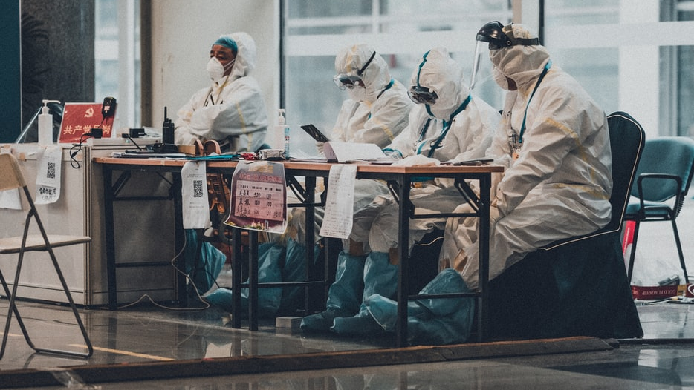
Sources
https://www.usatoday.com/in-depth/news/2020/01/29/coronavirus-what-are-symptoms-of-wuhan-china-novel-virus/4563892002/
https://datahub.io/core/covid-19#resource-covid-19_zip
https://www.isglobal.org/en/-/coronavirus-myths-and-truths
https://unsplash.com/s/photos/coronavirus
Ahmed Abdulwahab

Slide 21

Thank you!
Ahmed Abdulwahab

Slide 22
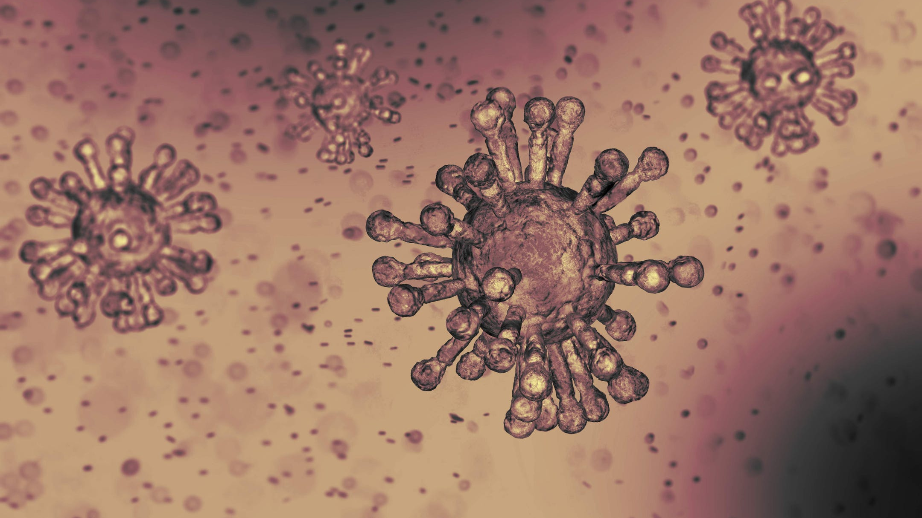
Any
Question?
Ahmed Abdulwahab

